Slide 1
Amazon Sales Data Analysis
By Unmilan Baruah

Slide 2
Introduction
Sales management has gained importance to meet increasing competition and the need for improved methods of distribution to reduce cost and to increase profits.Sales management today is the most important function in a commercial and business enterprise. Amazon is an e-commerce platform that sells many product lines, which are preferred by consumers all around the world. This report is a detailed analysis of Amazon Sales Data from 2010 to 2017.

Slide 3
Purpose
To find and study region/country-wise sales trend of Amazon Sales Data.
To find the sales trend of the Amazon Data using time-series analysis.
To evaluate the overall of Revenue, Profit, and Cost from 2010 to 2017.
To analyze the sales trend based on Order Priority.
To analyze the sales trend based on Item Type.
To analyze the sales trend based on Sales Channel.

Slide 4
Methodology
ETL (Extract, Transform, and Load): Collecting the data, transforming it into something which can be analyzed with accuracy, and loading the processed data for further analysis.
Data Analysis
Observations
Inference

Slide 5
ETL (Extract, Transform, and Load)
The data source is named as “Amazon Sales Data.csv” and this CSV file has sales records from 2010 to 2017.
There are total 100 entries, but no null values. Therefore, data cleaning was not required.
For the time series analysis, in Google Colab, the date format of “Order Date” column, which was in YYYY-MM-DD, was transformed into three different columns: order_day, order_month, and order_year. However, it was no such transformation was needed in Tableau.

Slide 6
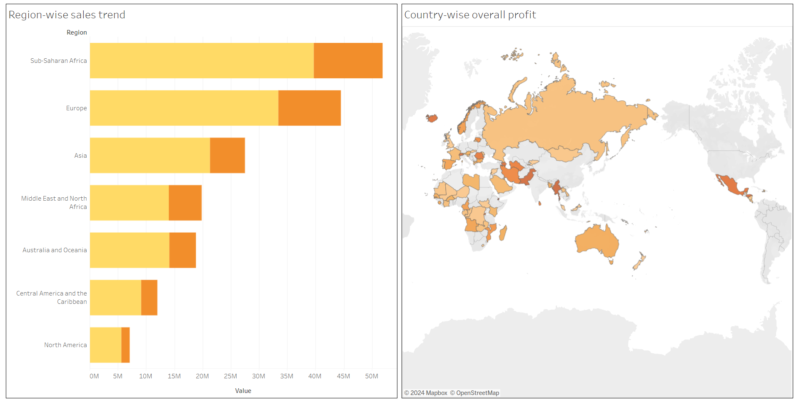
Data Analysis

Slide 7
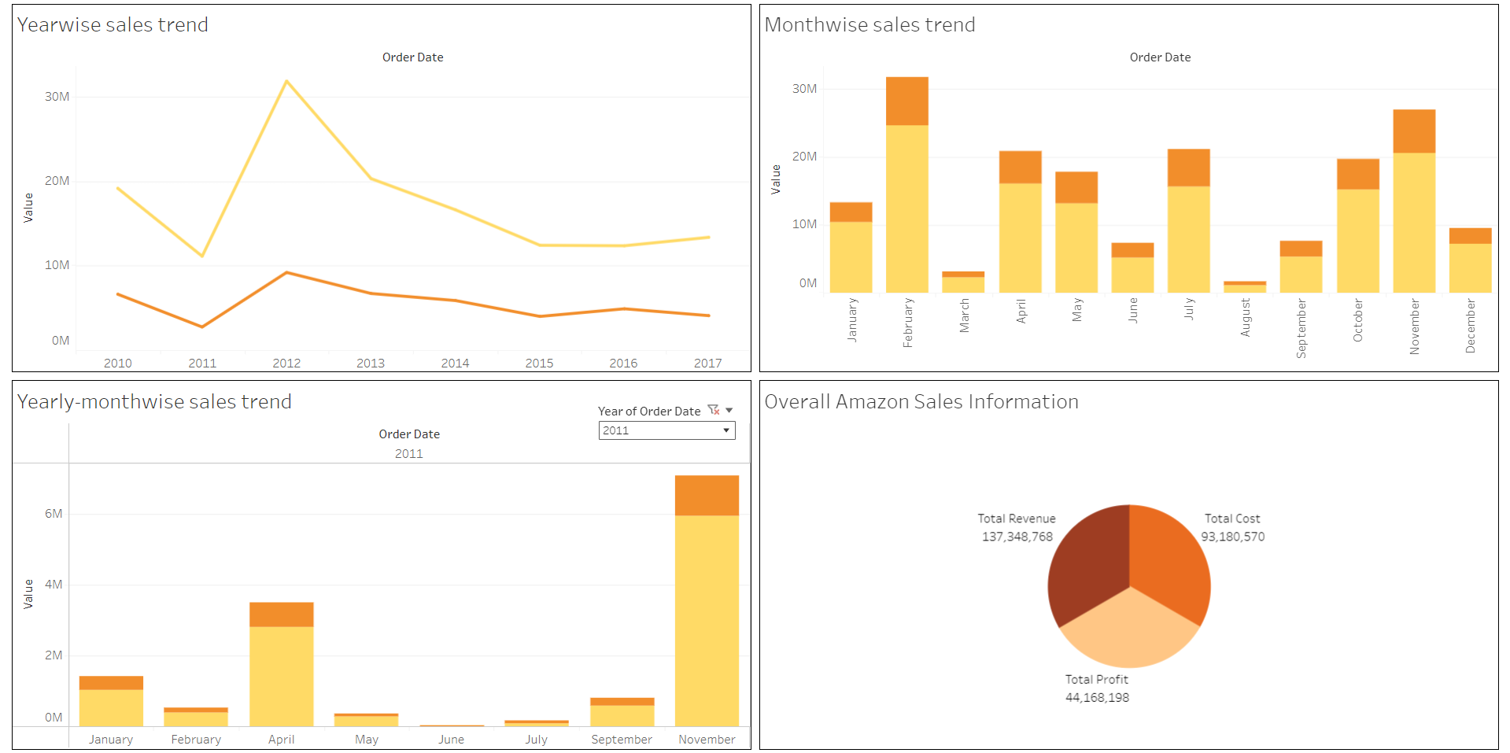
Data Analysis

Slide 8
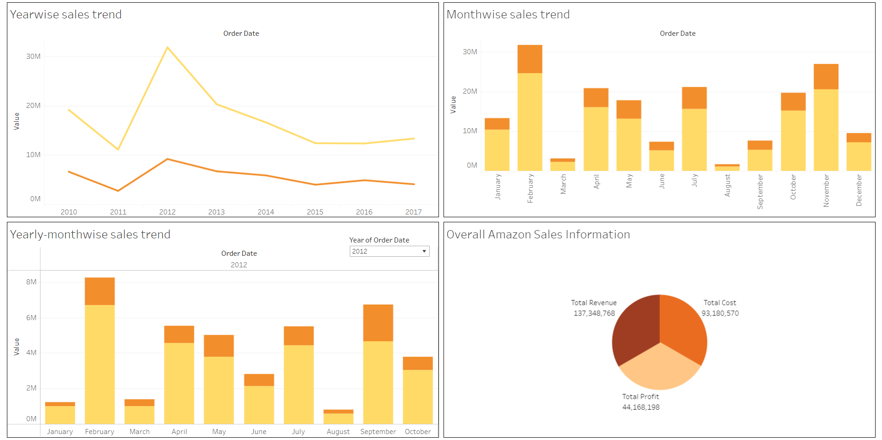
Data Analysis

Slide 9
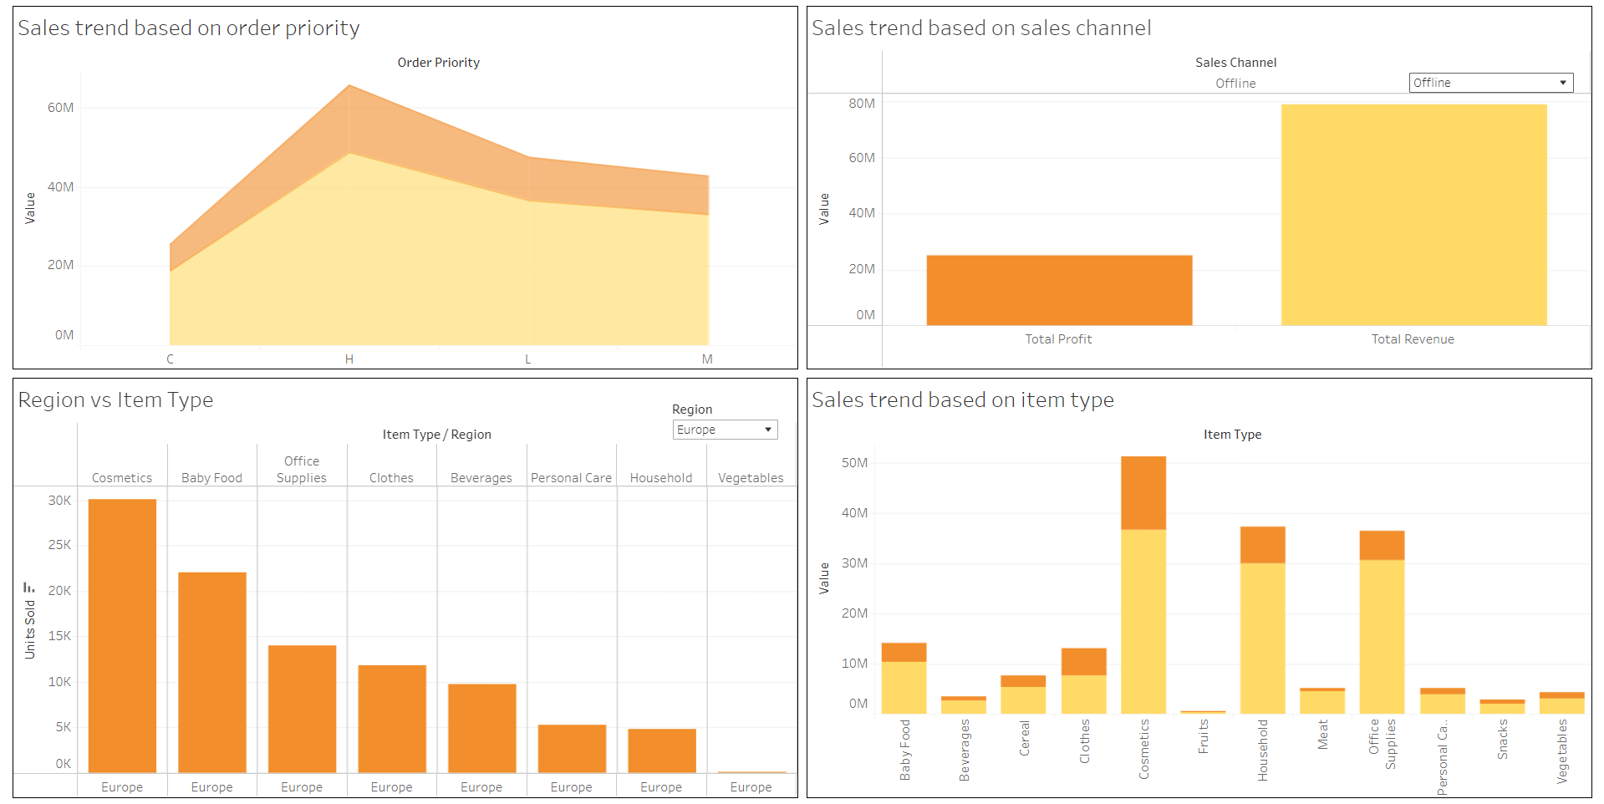
Data Analysis

Slide 10
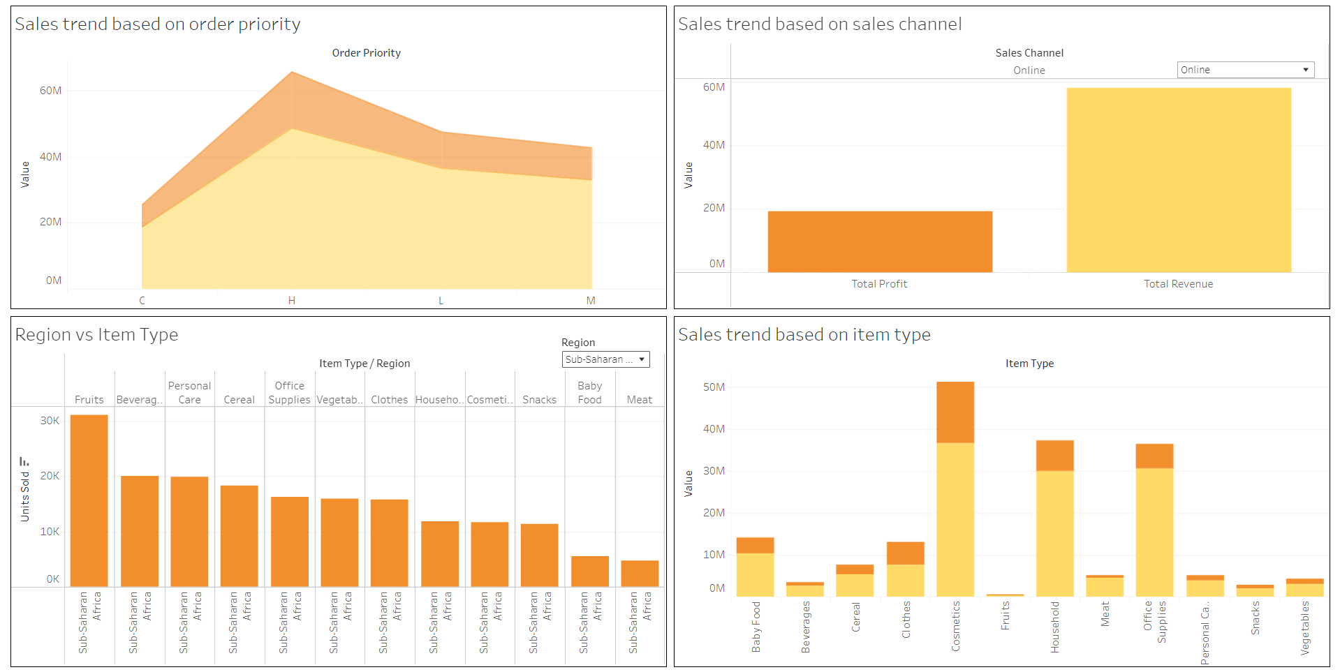
Data Analysis

Slide 11
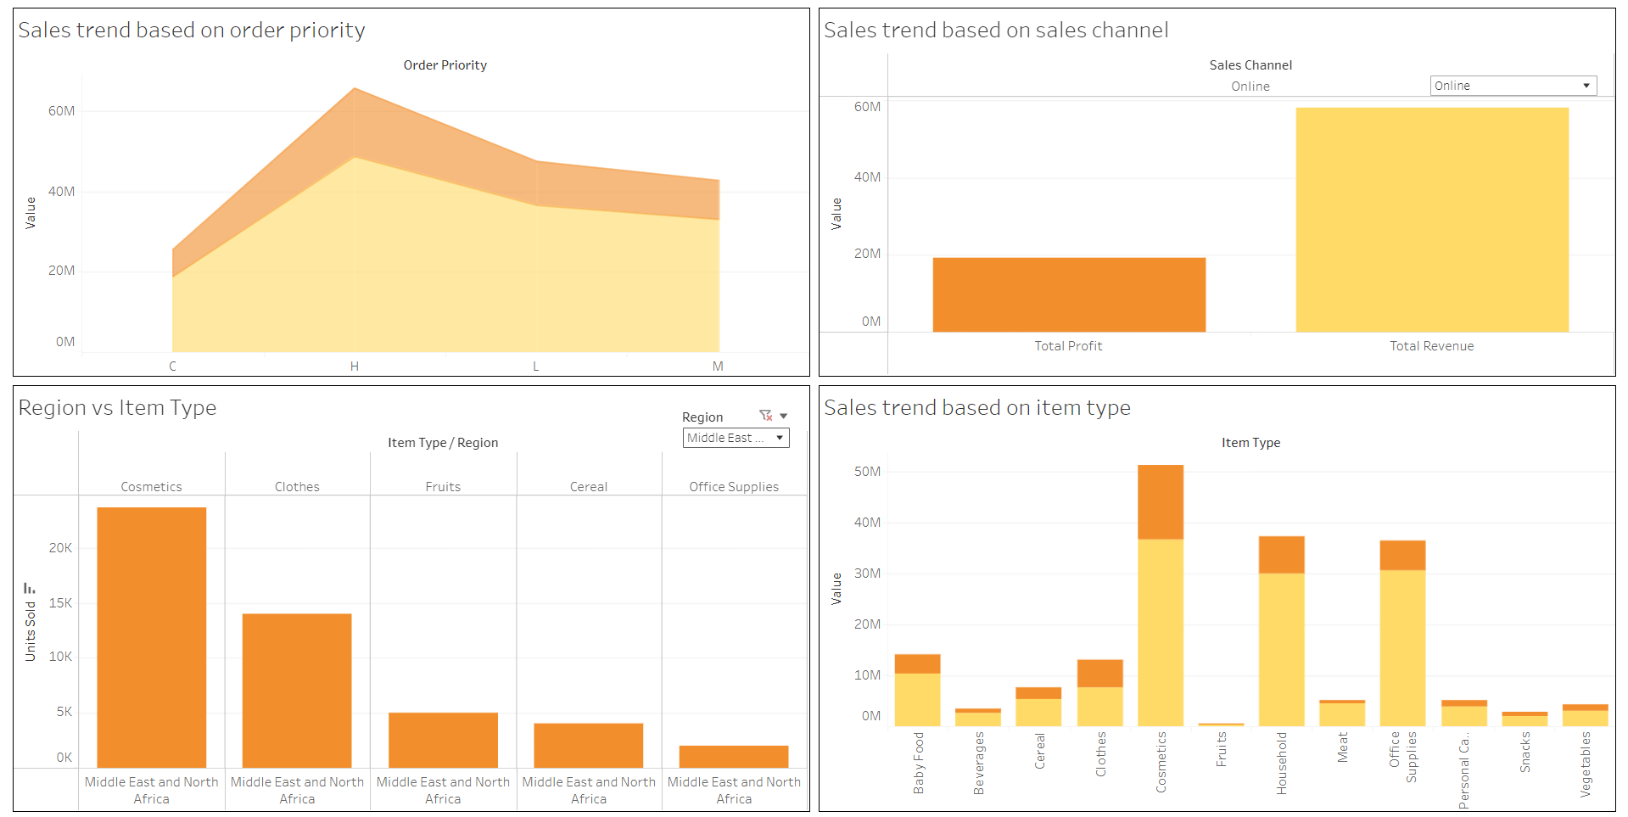
Data Analysis

Slide 12
Observations
Overall Revenue made from 2010-17 is $134 million. From this revenue, overall Cost, and Profit made are $93 million, and $44 million, respectively.
Sales trend is found out to be the highest in Sub-Saharan Africa region.
The overall sales (Profit, and Revenue) is highest in the year 2012, and the lowest in the year 2011.
People needs their products fact. This is because the order priority “H” is bringing the highest sales.
Higher sales are observed for “Offline” sales channel, meaning people still prefer buying their products offline.

Slide 13
Inference
Cosmetic products are sold the most in Europe, and Middle East and North Africa regions. So, it is better to promote Cosmetic products in those two regions.
Fruits are are sold the most in Sub-Saharan Africa region. There, it will be better to promote Fruits products in the region, followed by Beverages as these products are the two most preferred item types in the region.
However, necessary changes are needed to made in prices for Fruits products, because the sales from Fruits products is the lowest overall. The same is the case for Beverages, as it has achieved the third most lowest sales overall.

Slide 14
Inference
Overall sales are highest for Cosmetics, followed by Household, and Office Supplies. Moreover, Household products are preferred the most in Central America and the Carribean as well as second most preferred products in North America, and Asia. So, it is also necessary to promote Household products with Cosmetics as well.
Also, Office Supplies are the third most preferred products in Asia, and Europe. Thus, necessary to promote Office Supplies, just like Cosmetics and Household products.
The least profit by region is observed in North America. Moreover, only Personal Care, and Household items are sold in this region. So, more study is necessary in the region to enhance the Profit in the region.

Slide 15
Thank You

